Slide 1
Check up
ELEN 7046
CONCEPT EVALUATION
12 MAY 2015 | VERSION 1.0

Slide 2
Content Layout
Concept Description
Process
High Level Business Requirements
Concept benefits & initial budget
Annexure 1: Benefit calculation
Annexure 2: References

Slide 3
Concept Description
Problem statement:
The project requires the development of a software solution to monitor the delivery of health services in communities. The proposed mechanism for this monitoring is a survey that will be conducted on a regular basis. The application will consist of – capturing(offline/online) and uploading, analysis and reporting.
Deliverables:
Project Code, Demonstration, Individual Presentation, Group Report, Individual Report
Deadline: 24 June 2015

Slide 4
Methodologies
The are a number of software development methodologies that can be adopted for this project. The approach that the team adopts, needs to consider the distribution of the team, the time available for the project, process intensity and artefacts required. My recommendation is that we use ICONIX as it requires less interaction than the SCRUM model and requires minimal artefacts. Here's a practical overview of the process:
Milestone 1: Requirements review
Quick Draft of Functional Requirements
Quick Definition of a Domain Model
Model Use Cases on the base of previous steps
Milestone 2: Preliminary Design Review
Optional - Draw a throw-away robustness diagram for each use case just to understand relations between your classes
Milestone 3: Detailed Design Review
Draw a Sequence Diagram for each use case
Model your test-cases on the use cases
Milestone 4: Deployment
Implement
Test
At each step you review your work as a whole updating your domain model (it's impossible to get it right first time) and adding comments on your use cases. By the end of step 5) you end up with ready-to-implement classes and logic with just little documentation to maintain if you re-factor or change anything:
Use case diagram
Sequence Diagram for each use case
Test case diagram (or test plan)

Slide 5
Functional Requirements
ID | Function
1 | Present the survey questions locally to the survey agent.
2 | Allow the local capture of the survey response
3 | Persist the survey responses locally
4 | Check for a connection to the central location
5 | Upload the locally persisted survey responses to the central location
6 | Persist the survey responses in the central location
7 | Allow interrogation of the centrally persisted survey response data
8 | Produce standard reports on the survey response data

Slide 6
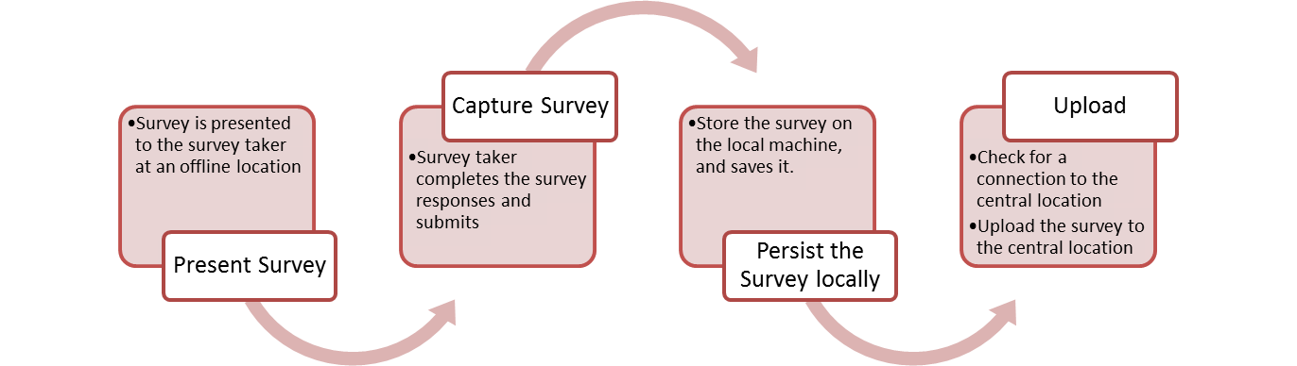

Title and Content Layout with Chart
Local
Central

Slide 7
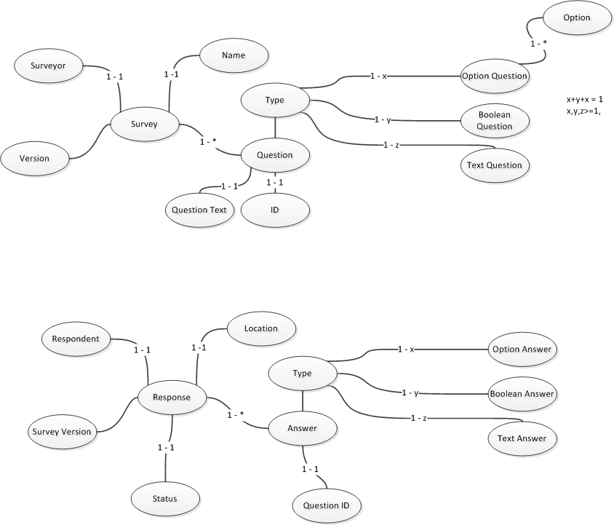
Domain Model

Slide 8
Use cases
ID | Use Case Name
1 | Access Survey
2 | Capture Survey
3 | Save Survey
4 | Submit Survey
5 | Upload Local Surveys
6 | Analyse Survey

Slide 9
Action Plan
ID | Actions | Owner | Date
1 | Review Milestone 1 Deliverables
2 | Incorporate feedback | Peter
3 | Complete Use Case Detail | Peter
4 | Define Questions
5 | Define Architecture(Concept Diagram, Deployment, Design and Technology) | Mike
7 | Develop UI Mock-up
7 | Review Milestone 1 Deliverables
8 | Incorporate Feedback | Peter
 | Milestone 1 complete |  | 15/05

Slide 10
Action Plan
ID | Actions | Owner | Date
1 | Robustness Diagram | Peter
2 | Sequence Diagram
3 | Test Cases
 | Milestone 2 and 3 |  | 20/05
1 | Development | Ronald
2 | Test
 | Milestone 4 Deploy |  | 05/06
 | Reports and Demo |  | 15/06

Slide 11
Decisions
ICONIX (Yes/No)?
Is the domain model correct i.t.o question types relationship to questions?
Is Plan doable?
Who can do which tasks?
Integration Options (Heavy – upload database sync, Light – email)
Architecture?
Analysis (configurable tool, or custom UI)

